Slide 1
lolihunters
(Group no-9)

Slide 2



Members
Siddharth 211P016-30
Ameen 211P025-14
Aditya 211P035-55

Slide 3

Project Title
Automatic Pet Feeder
(Using IOT)

Slide 4
Introduction
If you have a pet in your home and you don’t have anyone to feed it when you are away from home then you definitely need some kind of machine to do this job. So here we are building a IoT Pet Feeder machine which is simple, efficient and cost effective. Using this machine you can feed your Pet by Google Assistant from anywhere in the world. You just have to say "Okay Google. Feed my pet" and rest of the things will be done by this machine. You can also set a specific time using Google Assistant to feed your Pet. For example Say "Okay Google. Feed my pet Today Morning" and it will feed your pet at previously specified time. Like this you can also set a specific time for noon and evening.

Slide 5
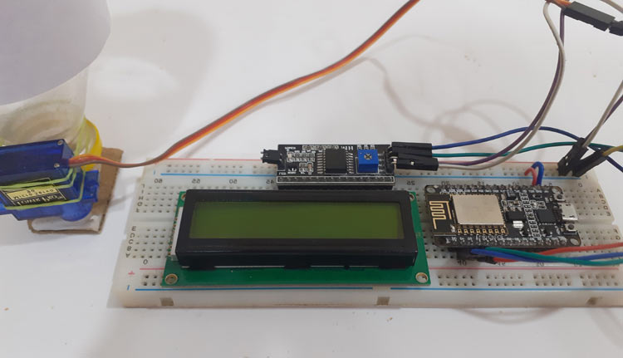
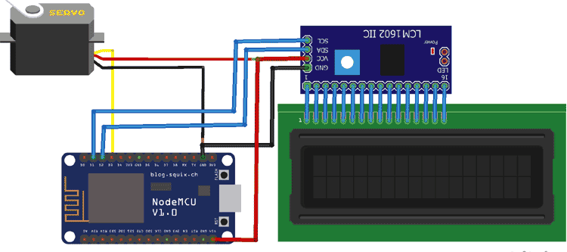
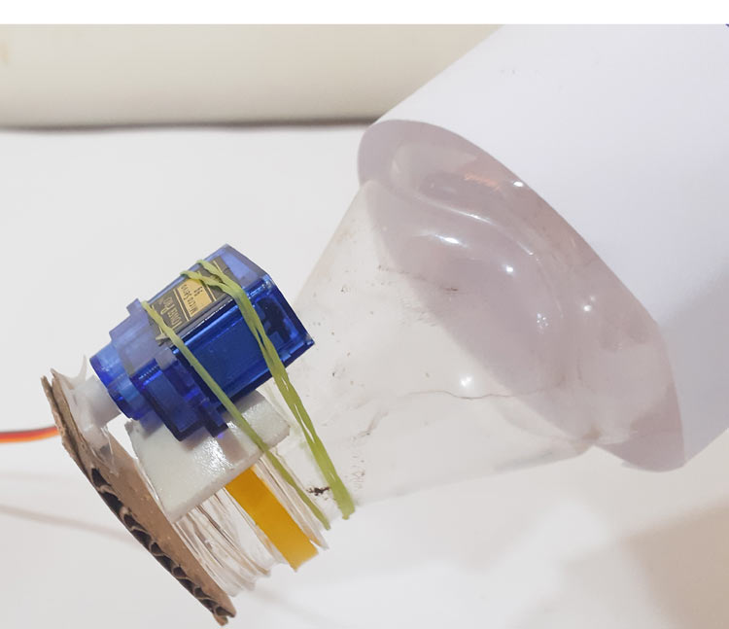
Concept Idea for IOT Pet Feeder:

Slide 6
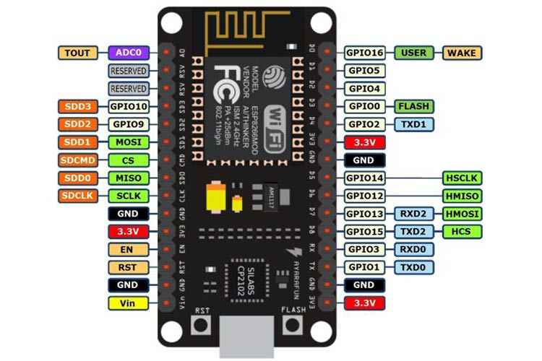
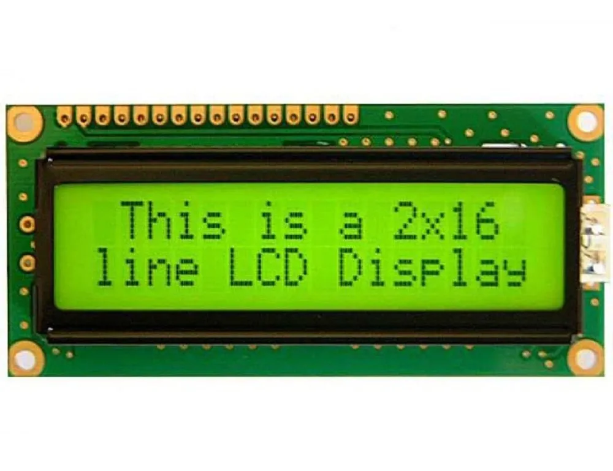
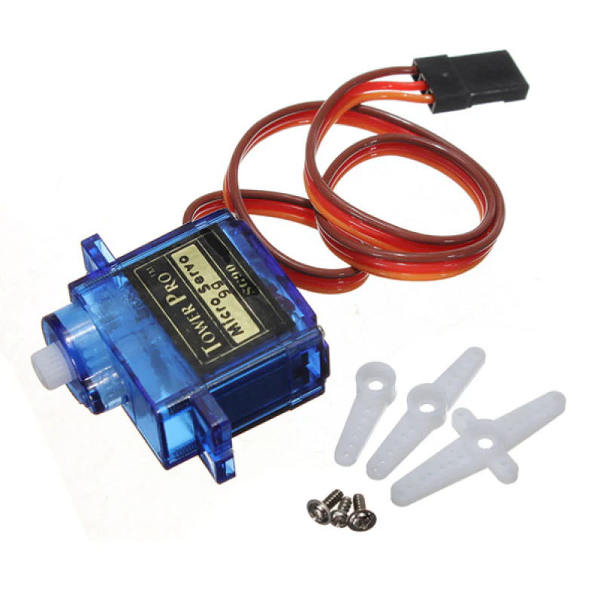
Components Required
NodeMCU ESP8266
16x2 LCD Module
LCD I2C Module
Servo Motor

Slide 7
Working of the IoT Pet Feeder
After uploading the code to the NodeMCU, the current time and Feed time will be displayed on the 16*2 LCD. Initially, it will show 0:0 in feed time as we didn’t enter any feed time. Now Say "Okay Google. Feed my pet" to your Google Assistant. Google Assistant will recognize the phrase and respond with "Feeding your pet." After that it rotates the servo motor from its initial position 0⁰ to 60⁰ and after a delay, it returns to its initial position. You can also feed your pet at a specific time. For that we have used three strings i.e., “Morning”, “Afternoon” and “Evening”. These strings are assigned with different times, so when you say “Feed My Pet Today Morning” it will take the time assigned to “Morning” string as feeding time and when the entered time matches with current time it rotates the servo motor from its initial position 0⁰ to 60⁰ and after a delay it returns to its initial position.

Slide 8
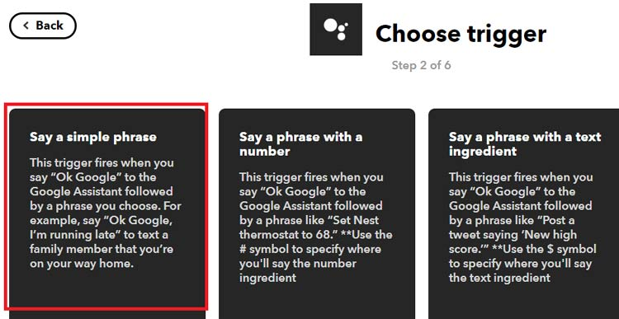
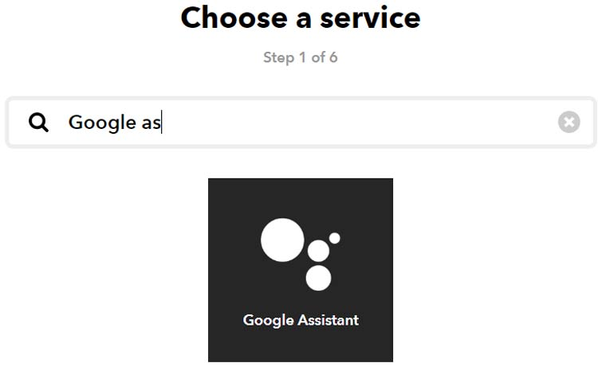
IFTTT Setup
IFTTT aka ‘If This Then That’ is a free web-based service to create chains of simple conditional statements, called applets. IFTTT allows users to create triggers and execute actions based on the triggers.
In this IoT cat feeder project, we are using IFTTT to create a trigger when we say a specific line using Google Assistant. For that we have to create an applet in which we will integrate the Google Assistant with Adafruit IO

Slide 9
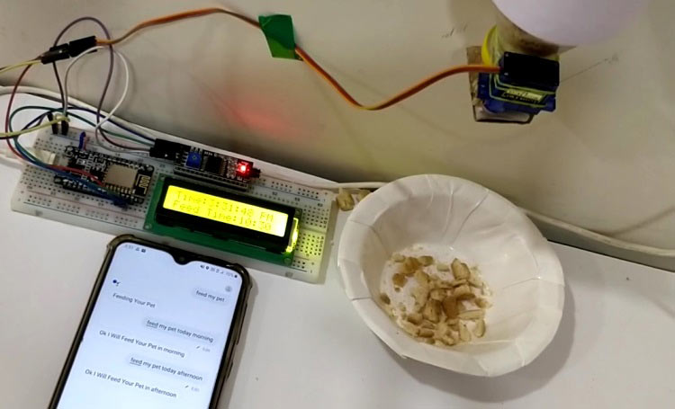
Google Assistant controlled
You can feed your pet using Google Assistant and other Virtual Assistants. If you want to feed your pet at a specific time instead of morning, afternoon and evening, go to IFTTT and change the Google assistant settings from ‘Say a phrase with text ingredient’ to ‘Say a phrase with a number’.

Slide 10
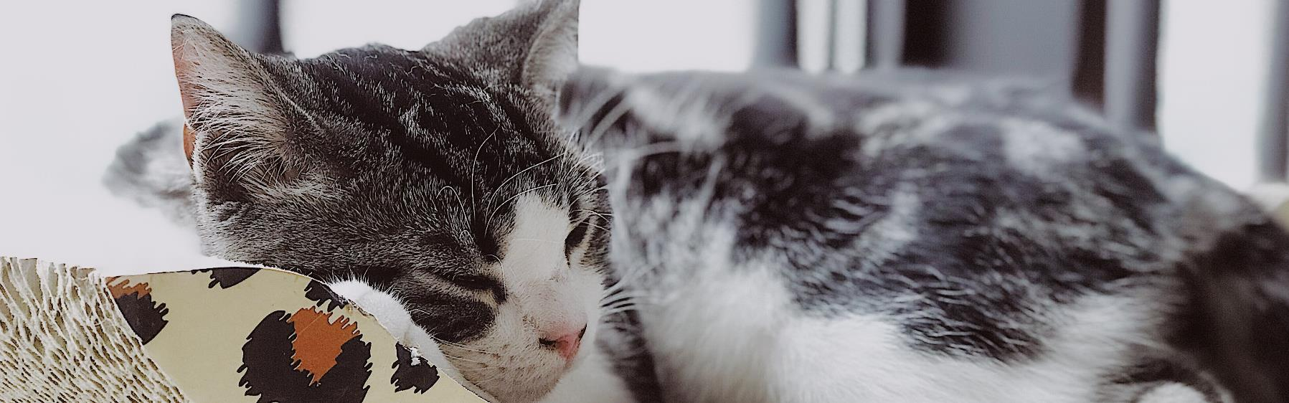
Thank you
MeOw!

